Slide 1
course overview
introduce myself
introduce course, what to expect
my background
undergrad
berkeley
google
thanks for taking the course

Slide 2
What is ML Fairness?

Slide 3
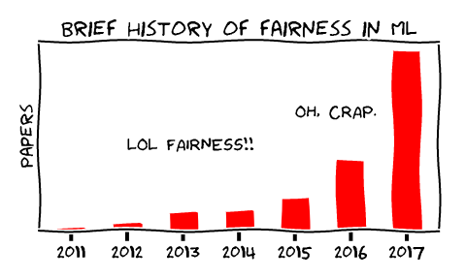
Fairness History, Informally
[source]
Notes:
Up until the 2010s, most people thinking about ML were focused on the statistical problems on learning from data, generalization, etc.
But all of a sudden, ML systems started to actually be used by lots of people.
This raised lots of new issues… what is the real experience of real people using these systems?

Slide 4
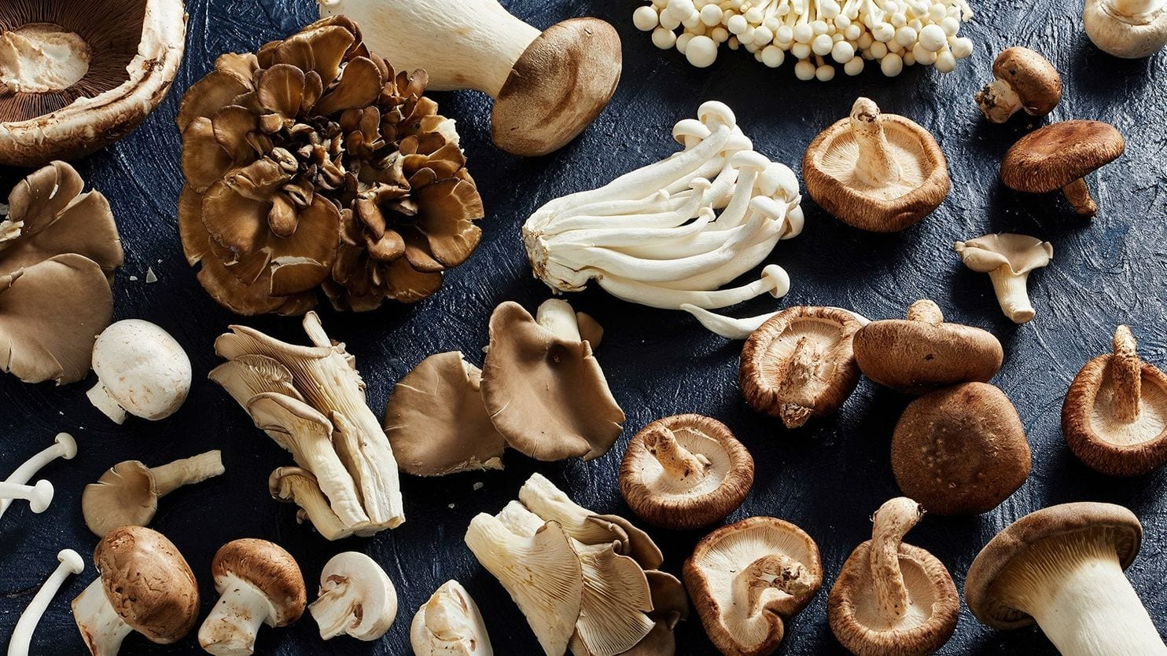
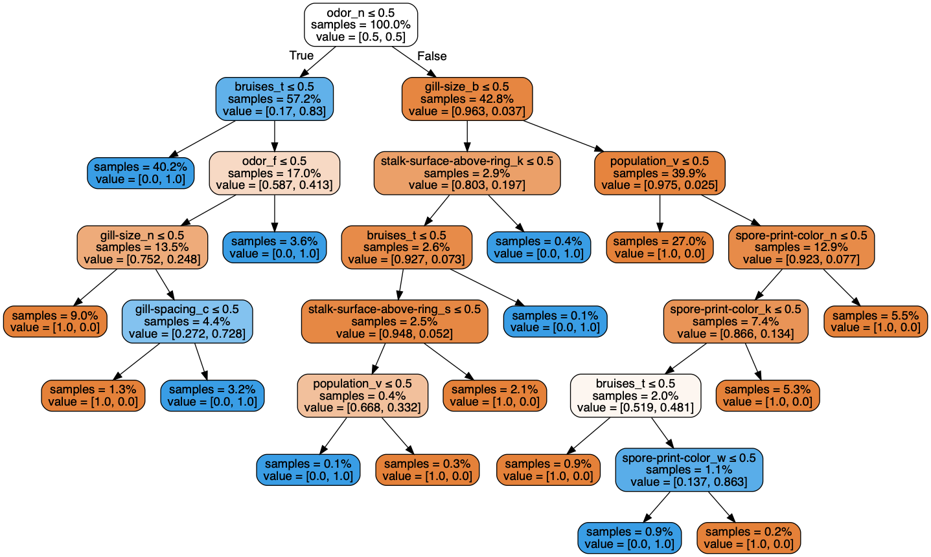
What is Fairness?
[source]

Slide 5
What is Fairness?
What could be unfair about a poisonous mushroom classifier?
Unfair to mushrooms?
Unfair to people?
[source]

Slide 6
What is Fairness?
What could be unfair about a poisonous mushroom classifier?
Unfair to mushrooms?
Unfair to people?
ML fairness refers generally to the intersection of ethics and ML
Terms like bias and fairness are overloaded
[source]
Notes:
ML is basically statistics, with some information theory and rebranding
As a field, it was not ready to confront societal implications of its adoption.

Slide 7
New Questions for ML
Machine Learning finds patterns in data for the purpose of generalization.

Slide 8
New Questions for ML
Machine Learning finds patterns in data for the purpose of generalization.
What data?
What patterns?
What kinds of generalization?

Slide 9
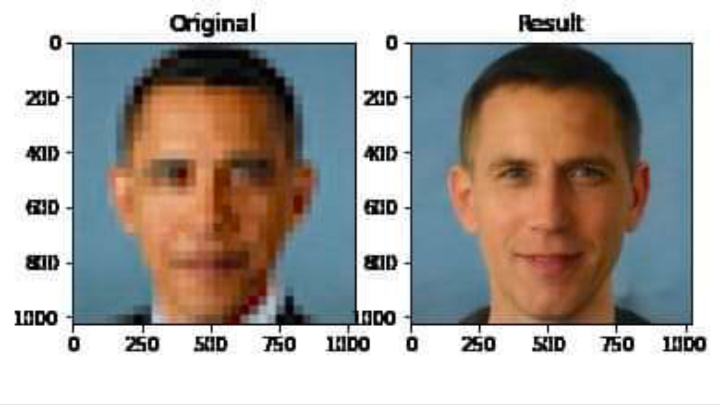
New Questions for ML
Machine Learning finds patterns in data for the purpose of generalization.
What data?
What patterns?
What kinds of generalization?

Slide 10
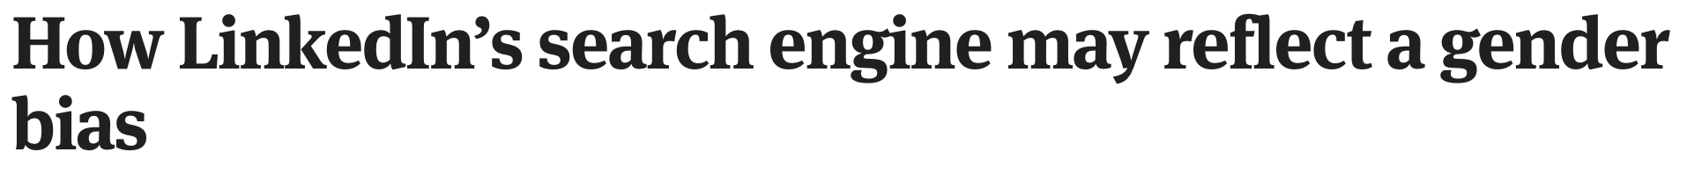
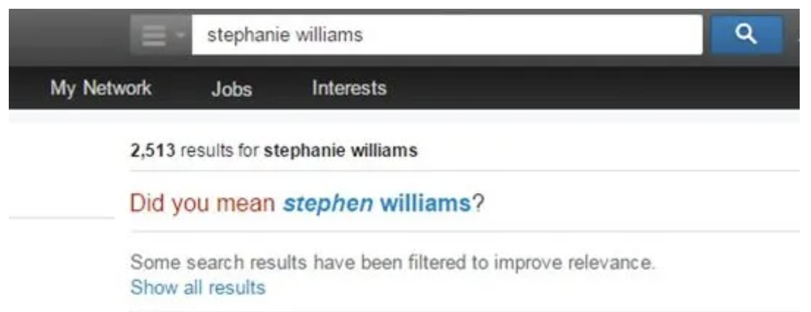
Examples: Gender Bias

Slide 11
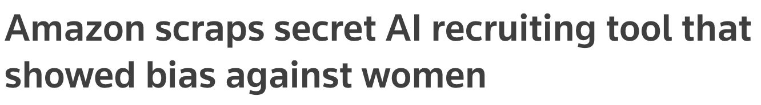
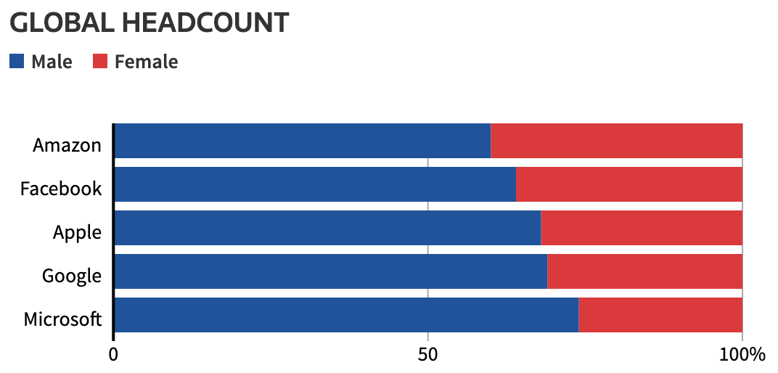
Examples: Gender Bias
Notes:
Amazon built a tool that tried to predict whether a candidate should be hired based on their resume.
But it was trained on previous hiring data, which included far more men than women.
They may have accidentally built a system that was closer to a gender predictor.

Slide 12
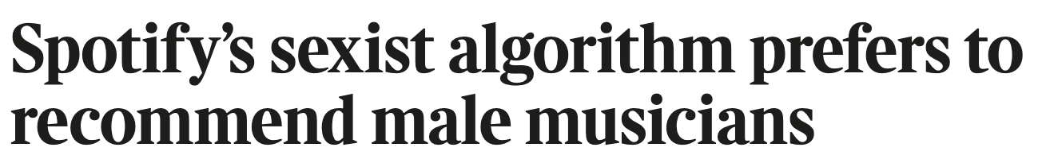
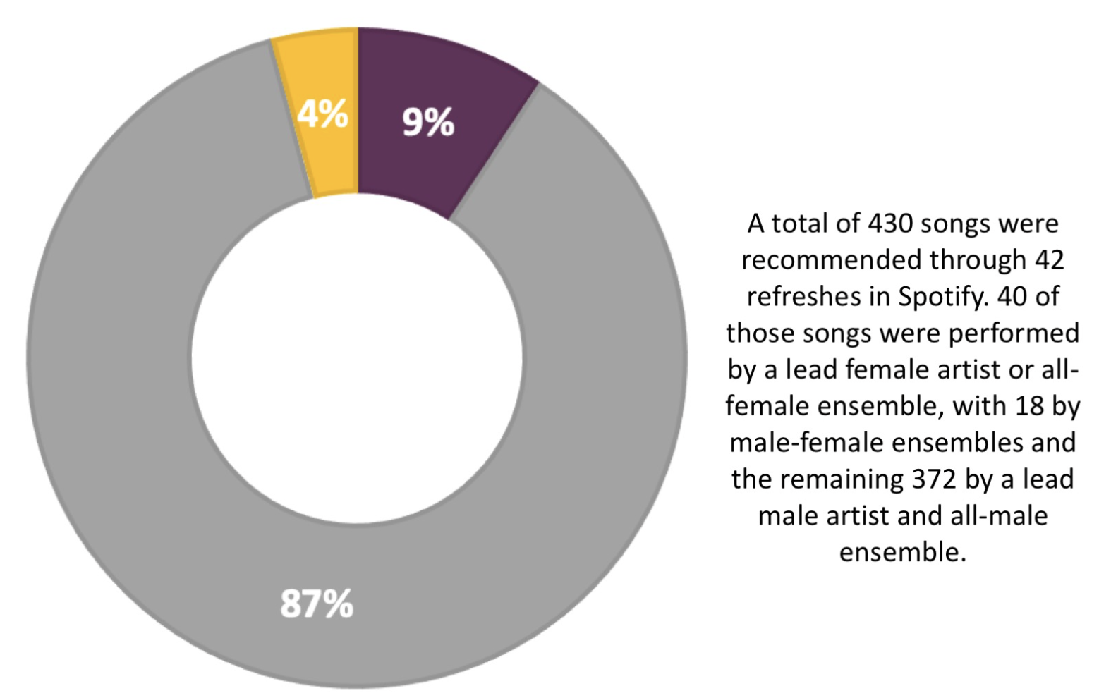
Examples: Gender Bias
Notes:
Often, by training a model on data with a particular bias (like more men than women), the resulting system actually amplifies this bias.

Slide 13
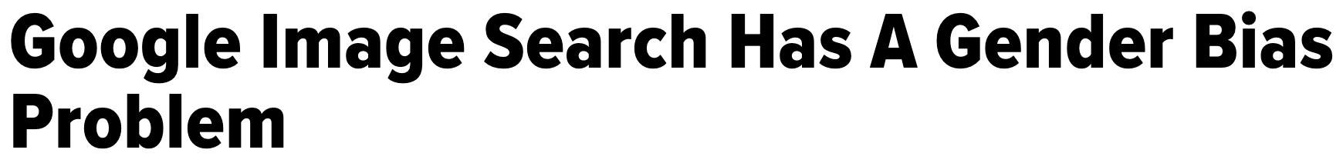
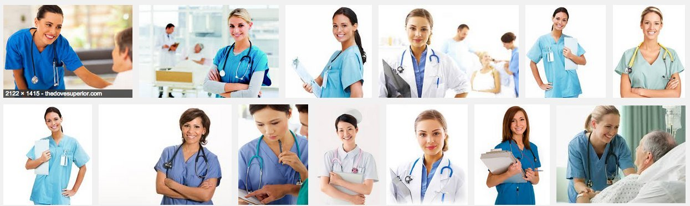
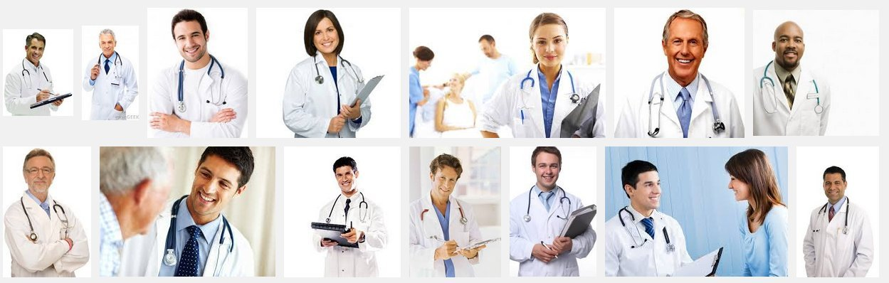
Examples: Gender Bias
“nurse”
“doctor”

Slide 14
Examples: Racial and Ethnic Bias

Slide 15
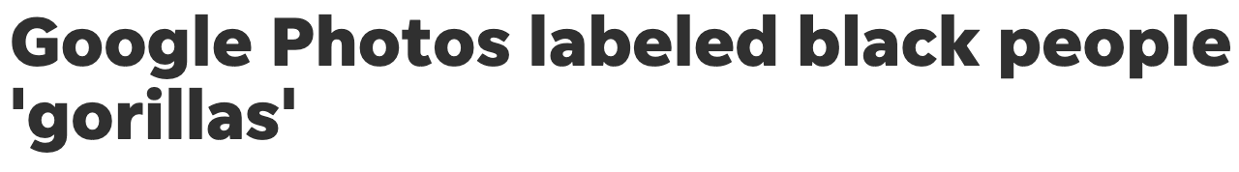
Examples: Racial and Ethnic Bias

Slide 16
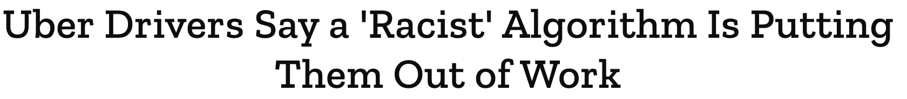
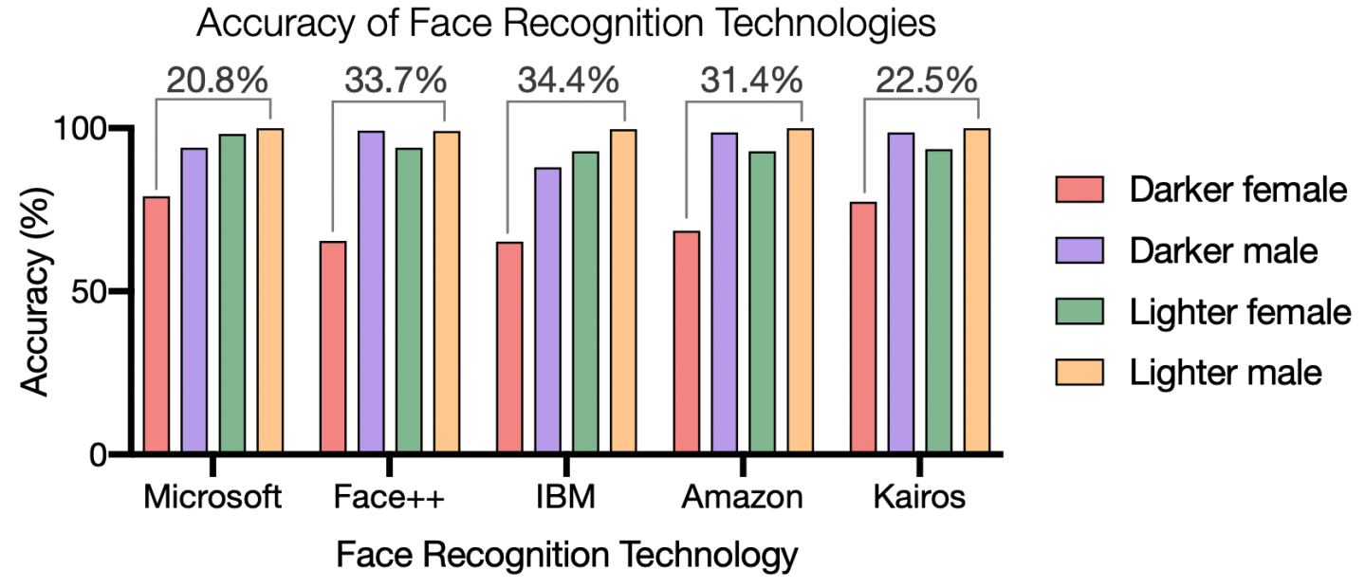
Examples: Racial and Ethnic Bias
[source]
Notes:
While at MIT, Joy Buolamwini studied accuracy of commercial face recognition systems and found big performance differences based on skin tone.
This research is documented in the Netflix documentary “Coded Bias”

Slide 17
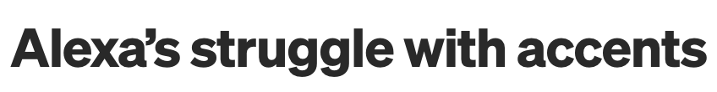
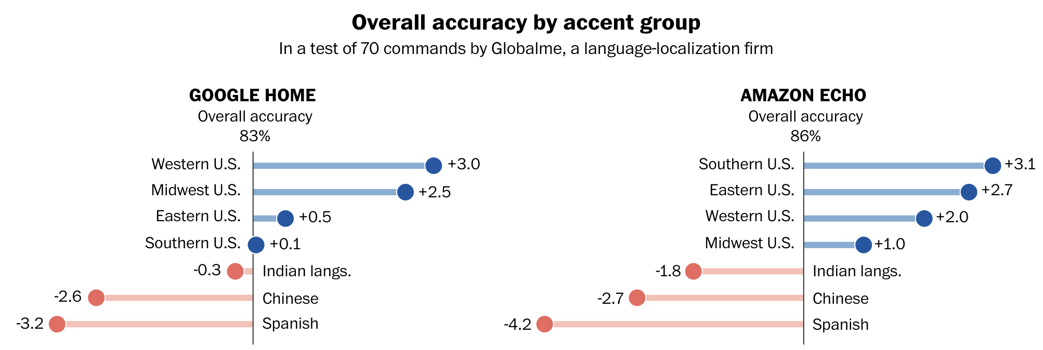
Examples: Racial and Ethnic Bias
[source]

Slide 18
Words of Caution
Ethics are complicated and sensitive
Hard to agree on high-level goals
Difficult technical problems
Notes:
(1) When all you want to do is fit models to data, things are pretty straightforward
But when you add ethics to the mix, the broader context is suddenly important
(how is the model being used? does it succeed and fail equally for all types of people? etc)
(2) It’s one thing to say we want our models to treat people fairly, but another say what that means in practice

Slide 19
What is ML Fairness?

Slide 20
Understanding Bias

Slide 21
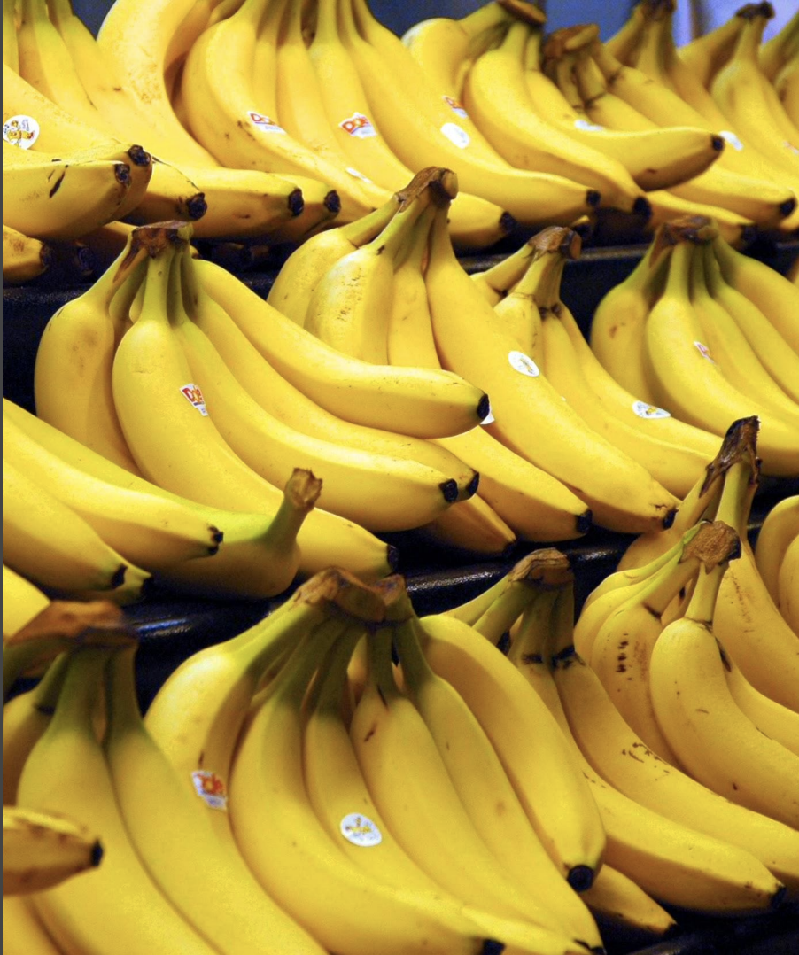
What Do You See?
[source]

Slide 22
What Do You See?
Bananas
Stickers
Dole Bananas
Bananas in a store
Bananas on shelves
Bunches of bananas
[source]

Slide 23
What Do You See?
Bananas
Stickers
Dole Bananas
Bananas in a store
Bananas on shelves
Bunches of bananas
But usually not “yellow bananas”
[source]

Slide 24
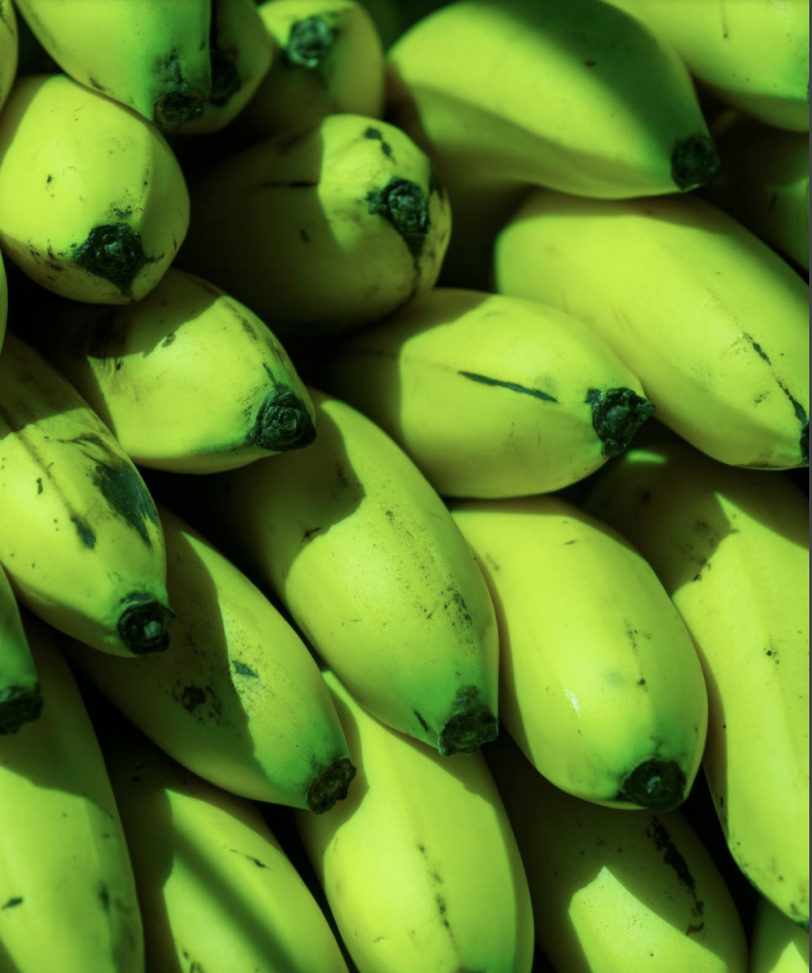
What Do You See?
[source]

Slide 25
What Do You See?
Green bananas
Unripe bananas
[source]

Slide 26
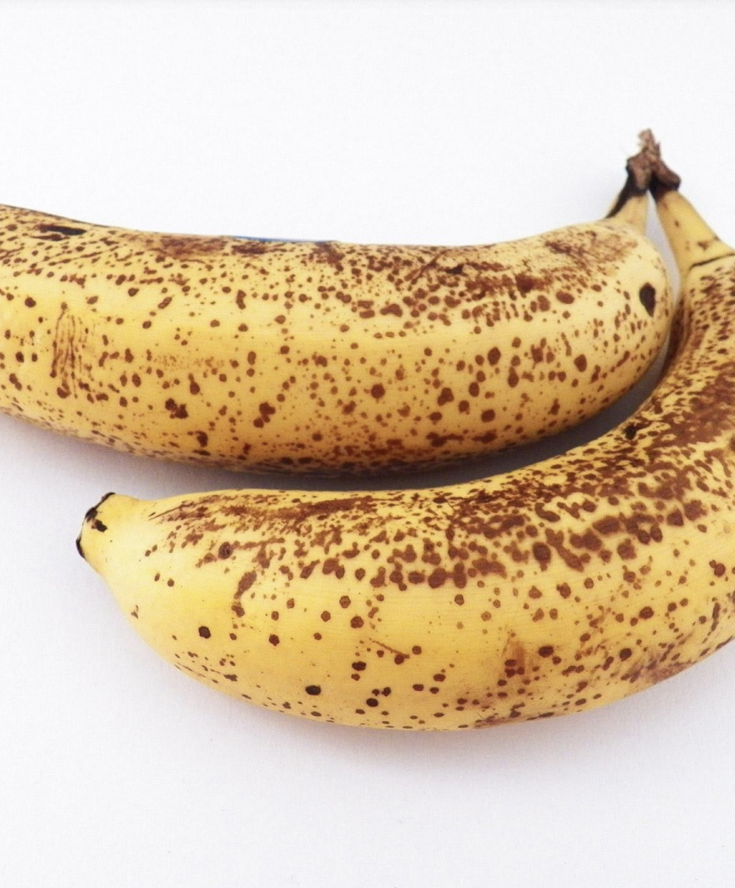
What Do You See?
[source]

Slide 27
What Do You See?
Ripe bananas
Bananas with spots
[source]

Slide 28
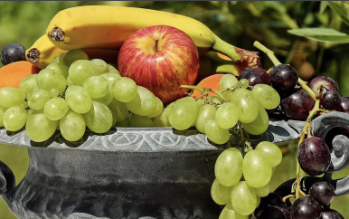
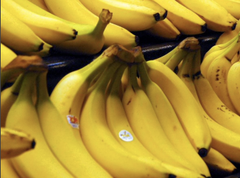
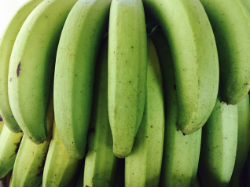
Prototype Theory
Humans use categorization to reduce the infinite differences among stimuli to practically usable proportions
Basic-level categories are often associated with clear sensory cues or consistent exemplars
Fruit
Bananas
“basic level”
Unripe/Green Bananas
Notes:
What does this mean for ML?
Well, we want to train models that understand the world using data we find on the web.
But if we just used text, for example, we would probably misunderstand the probability that a banana is yellow
That is, the language we use makes assumptions about what other humans already know.
When asked what I had for breakfast, I wouldn’t say that I ate a “yellow banana”
So this introduces a particular kind of bias into the text data on the web.

Slide 29
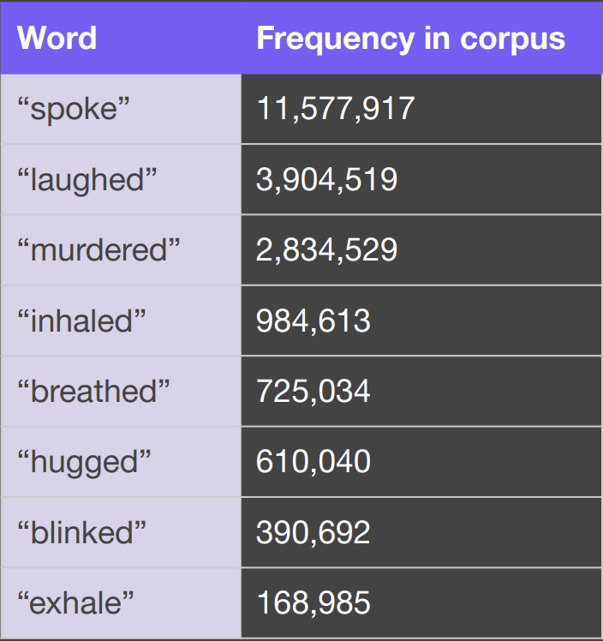
Human Reporting Bias
Observed frequency of written text does not reflect actual frequency of underlying events, properties, or human characteristics.
[source]
Notes:
Gordon and Van Durme lay out some of the difficulties of learning about the world from text.

Slide 30
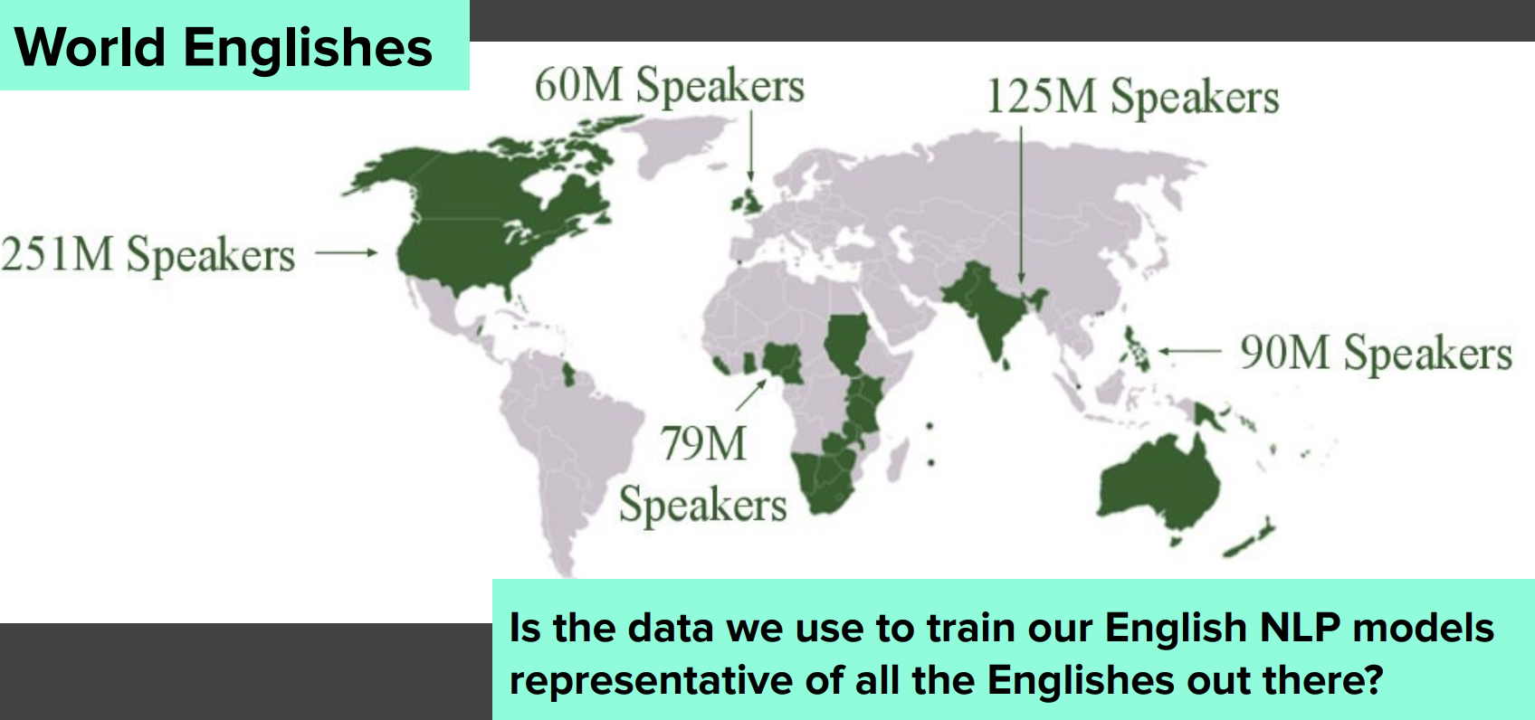
Selection Bias: English Text
Notes:
Data used to train our models does not reflect a random sample of the world
Most of the English used to train models derives from the US but most of the English spoken in the world is actually outside the US

Slide 31
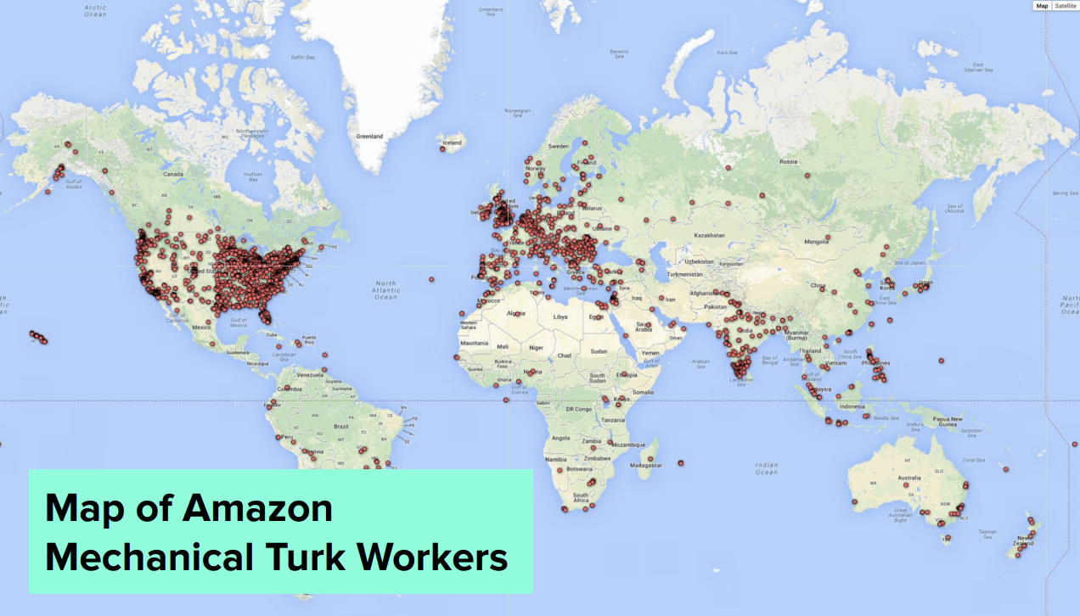
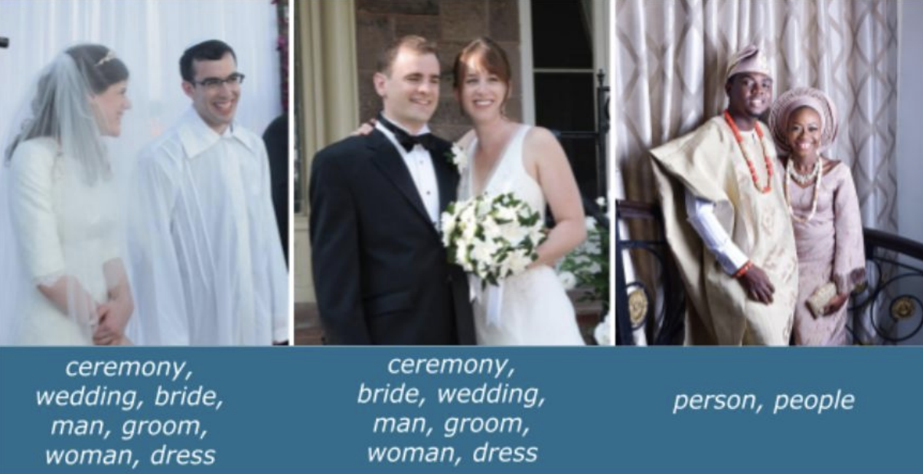
Selection Bias: Annotation
[source]

Slide 32
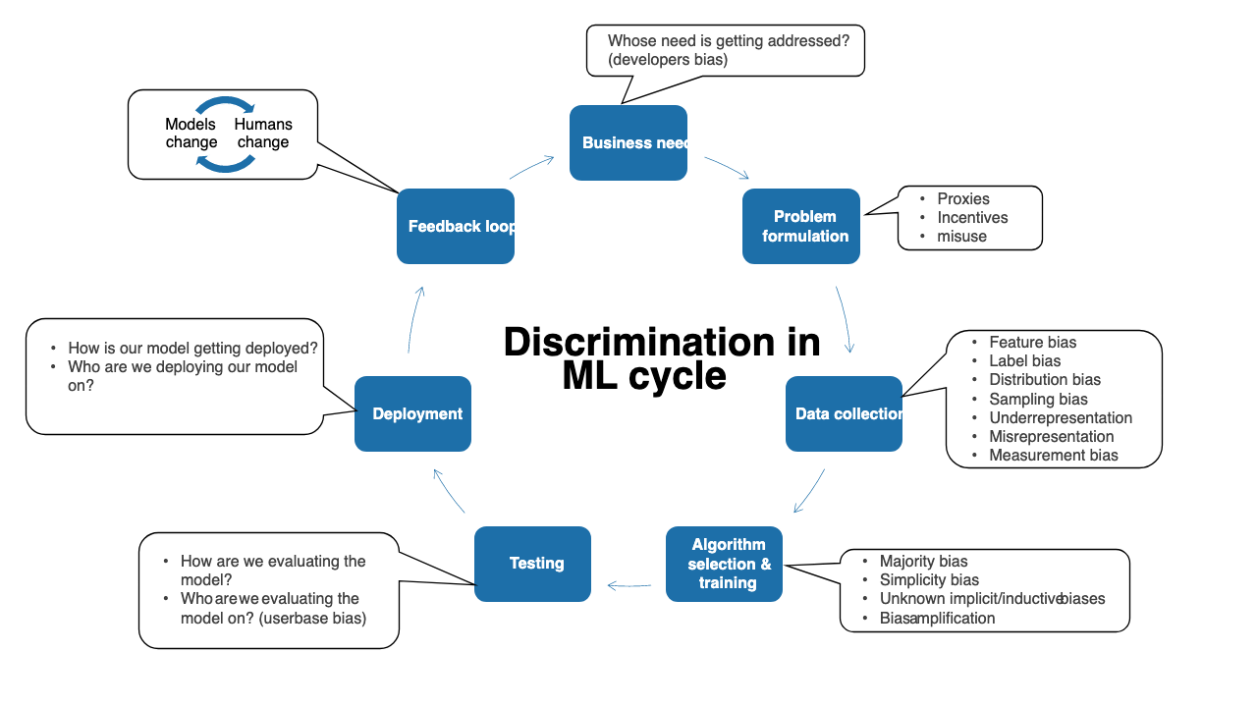
Bias in ML Systems
[source]

Slide 33
Bias is Overloaded
Bias in Statistics/ML
The bias term (y = wx + b)
Bias/Variance tradeoff
Estimator bias (difference between true and expected parameter value)
Cognitive Bias
Confirmation bias, Recency bias, etc.
Algorithmic Bias
Unfair/prejudicial treatment of people based on protected characteristics
Bias ~ Any systemic difference between intention and reality

Slide 34
Understanding Bias

Slide 35
Murky Applications of ML

Slide 36
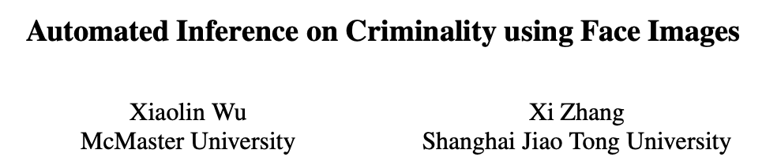
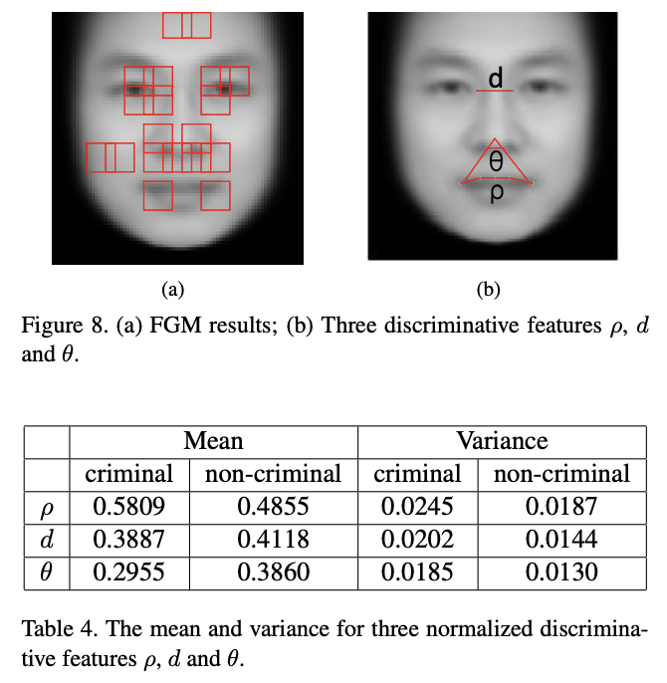
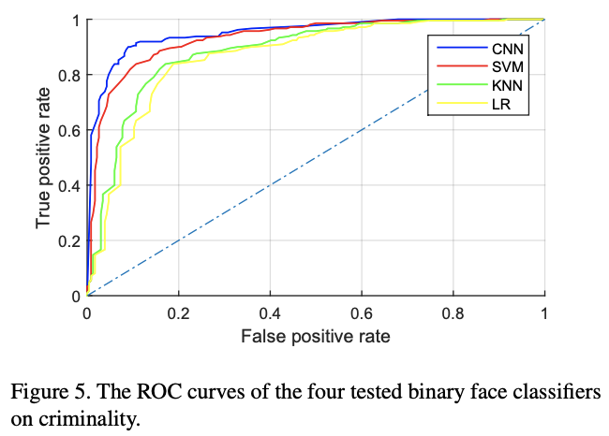
Predicting Criminality
Notes:
Physiognomy – inferring character traits from facial features
Phrenology – study of brain shapes to deduce mental ability

Slide 37
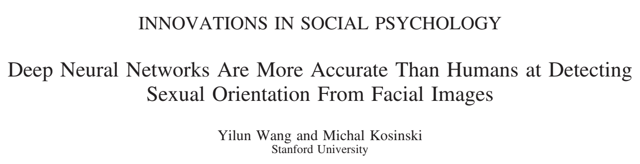
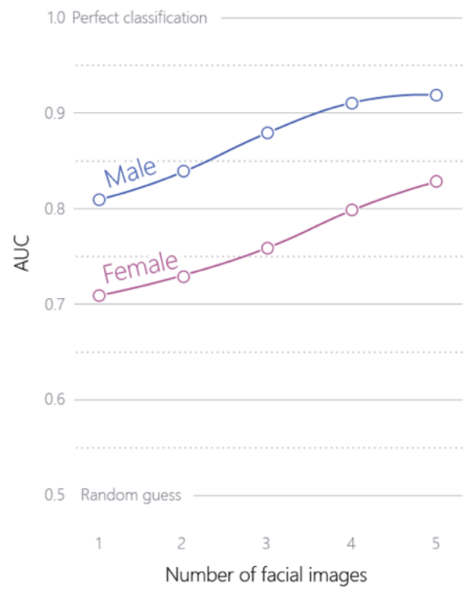
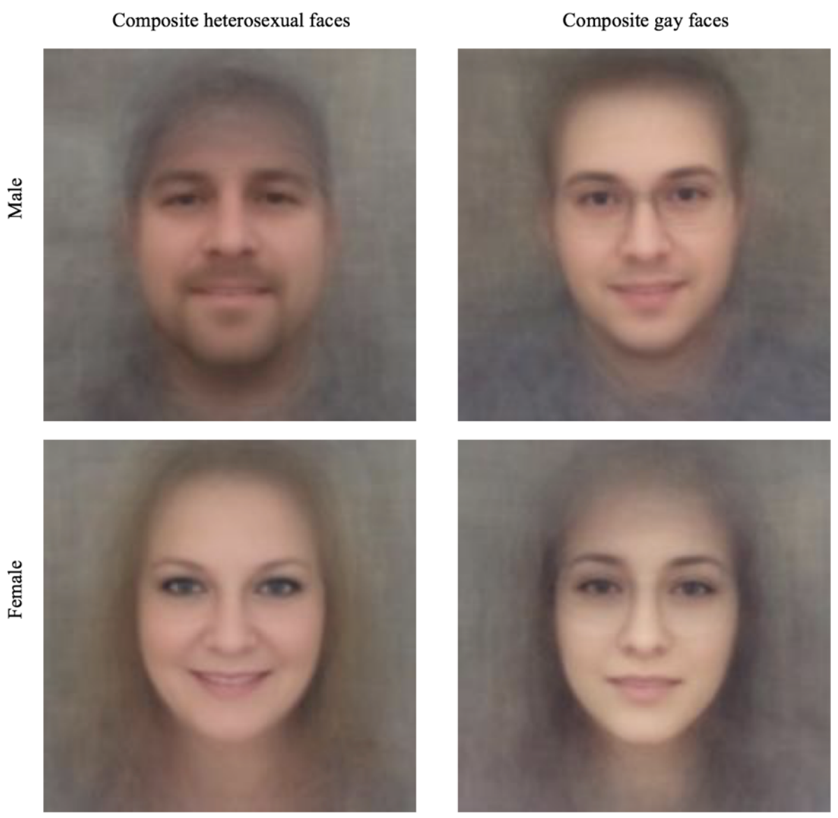
Predicting Sexual Orientation

Slide 38
Murky Applications of ML

Slide 39
Sub-Group Evaluation

Slide 40
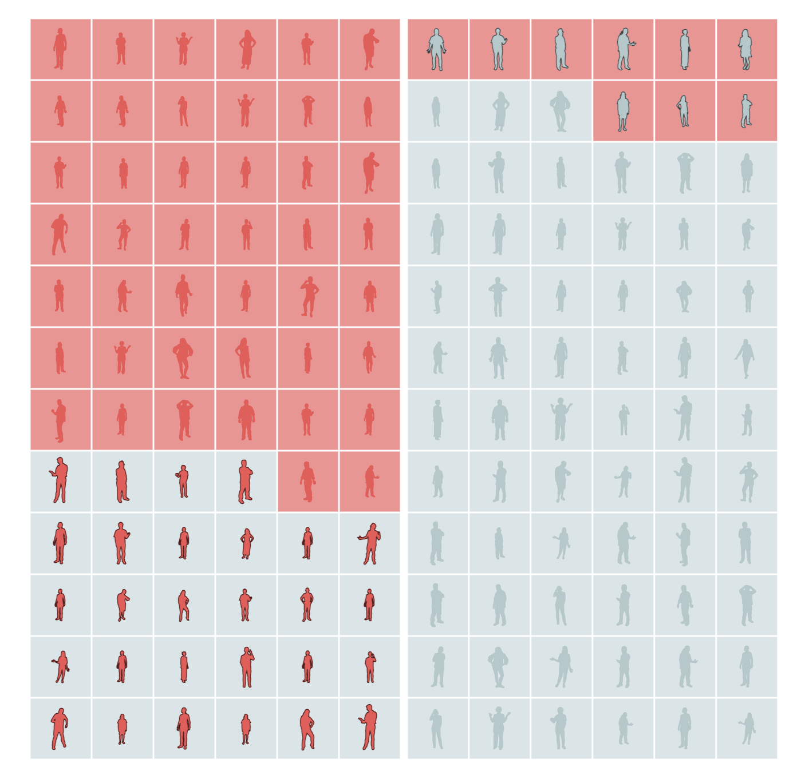
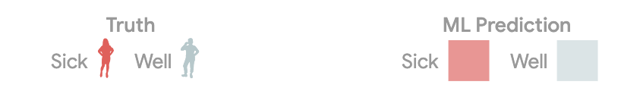
Sub-Group Metrics
Suppose we have an ML system for detecting a disease
The model might work differently for different groups of people
Notes:
TP – top left
TN – bottom right
FP – top right
FN – bottom left

Slide 41
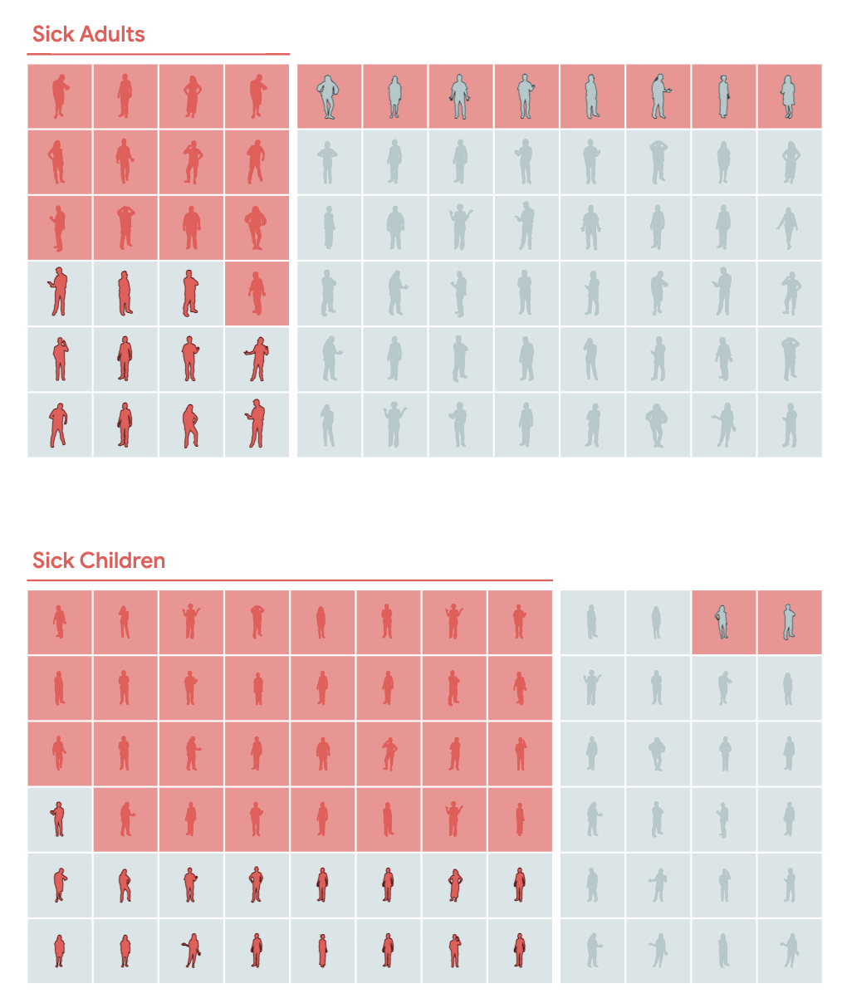
Sub-Group Metrics
Compare adults and children
How does recall compare for these sub-groups?
How does precision compare for these sub-groups?

Slide 42
Sub-Group Recall
Recall
Adults: 13/24 = 54%
Children: 31/48 = 65%
If a person has the disease the model is more likely to detect it if they are a child than an adult.
Notes:
recall = TP / TP + FN

Slide 43
Sub-Group Precision
Precision
Adults: 13/21 = 62%
Children: 31/33 = 94%
If the model detects a disease, it is more likely to be correct for children than for adults.
Notes:
Precision = TP / TP + FP

Slide 44
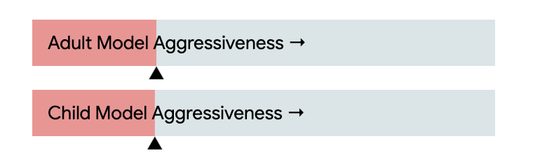
Sub-Group Metrics
Can we improve these fairness metrics by adjusting the model thresholds?
Equal Precision : Predictive Parity
Equal Recall : Equality of Opportunity

Slide 45
Sub-Group Evaluation

Slide 46
Data Augmentation

Slide 47
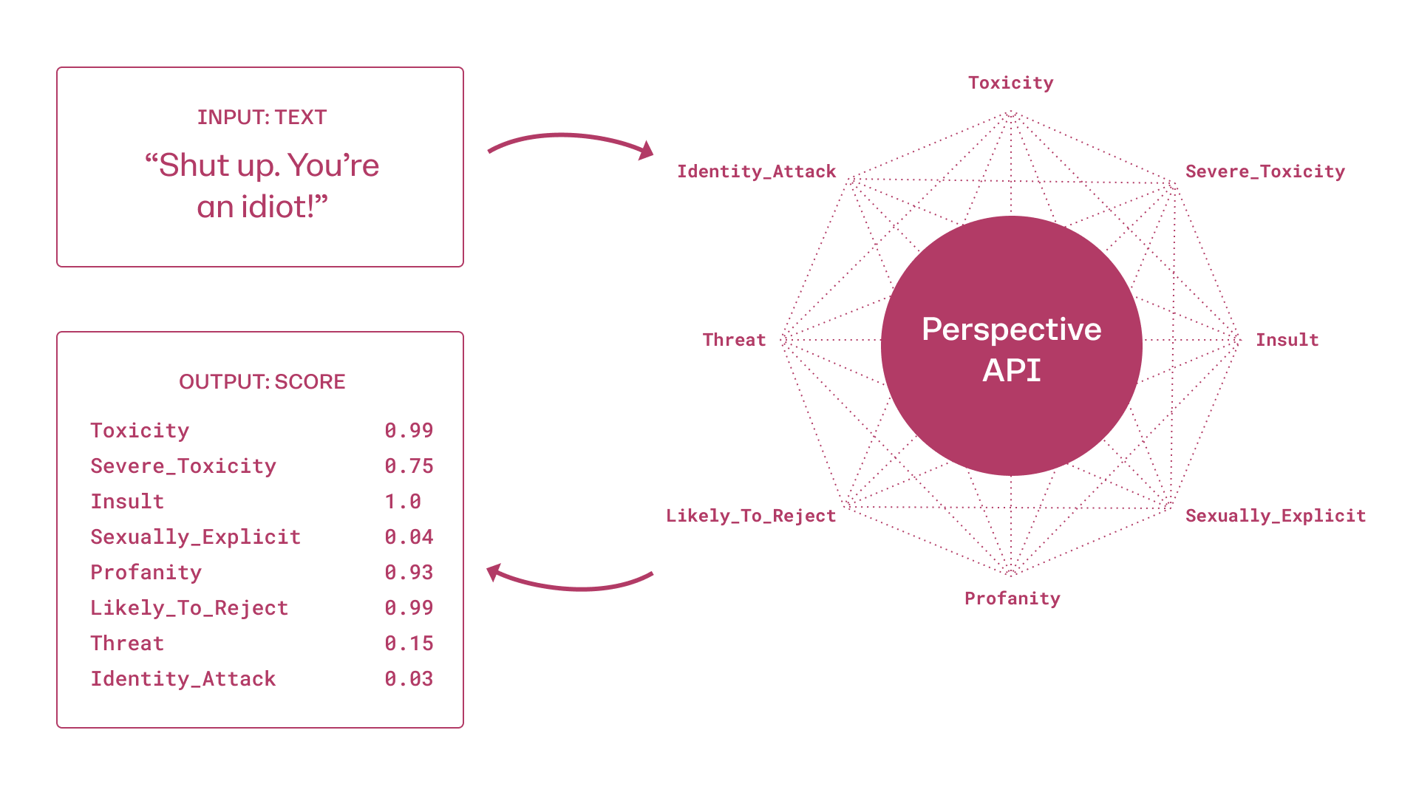
Perspective API
[source]

Slide 48
Unintended Model Behavior
Toxic comment classification
Trained on labeled comments
Exposed a classification API to Internet users…

Slide 49
Unintended Model Behavior
Comment Score
The Gay and Lesbian Film Festival starts today. 0.82
Being transgender is independent of sexual orientation. 0.52
A Muslim is someone who follows or practices Islam. 0.46

Slide 50
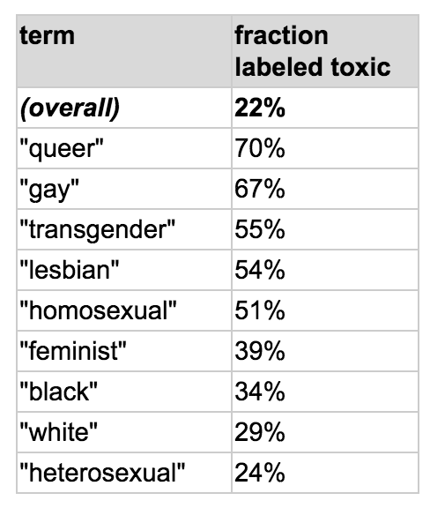
Dataset Biases
What makes a comment toxic can be subtle/nuanced
Model takes any available “shortcuts” when learning
One simple way to limit these shortcuts is by limiting their usefulness

Slide 51
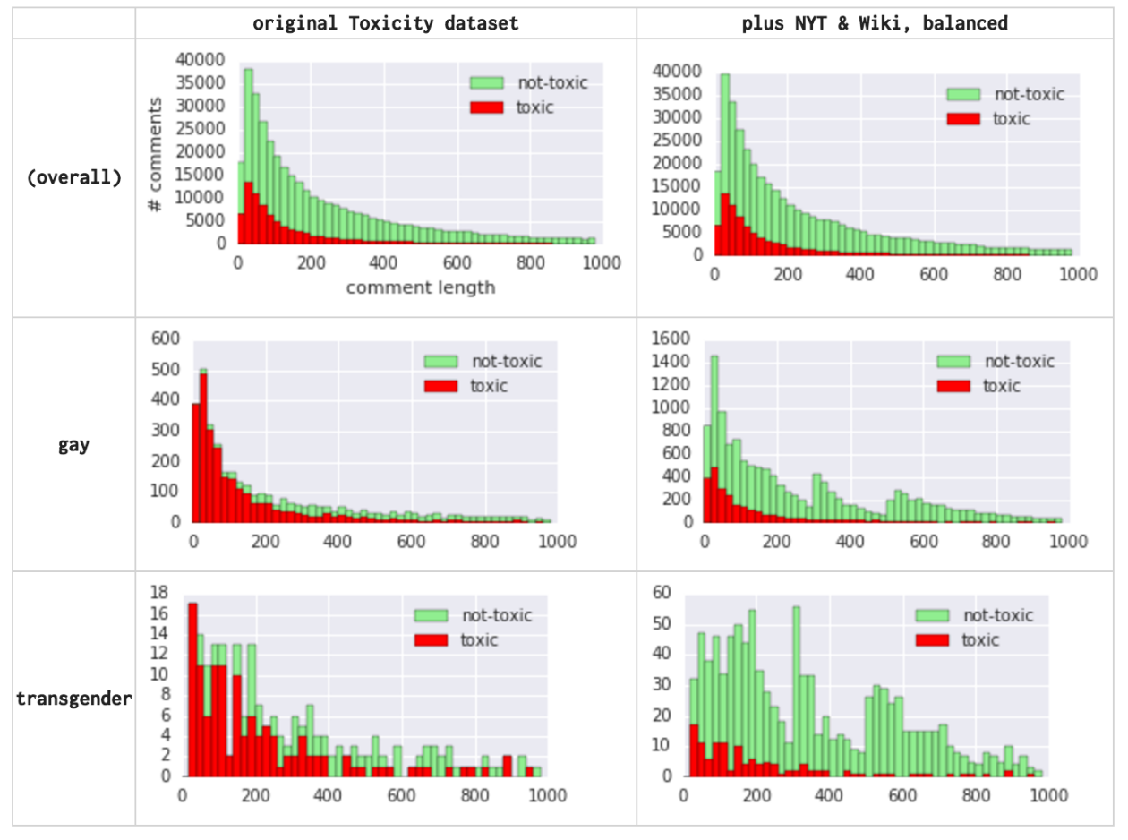
Augmented Data
Notes:
The data augmentation strategy is to make the distribution of comments with certain keywords similar to the overall distribution so that from the model’s perspective, these words are no longer clear indicators of toxicity.

Slide 52
Corrected Model Behavior
Comment Score Aug. Score
The Gay and Lesbian Film Festival starts today. 0.82 0.01
Being transgender is independent of sexual orientation. 0.52 0.05
A Muslim is someone who follows or practices Islam. 0.46 0.13

Slide 53
Data Augmentation

Slide 54
Adversarial Training

Slide 55
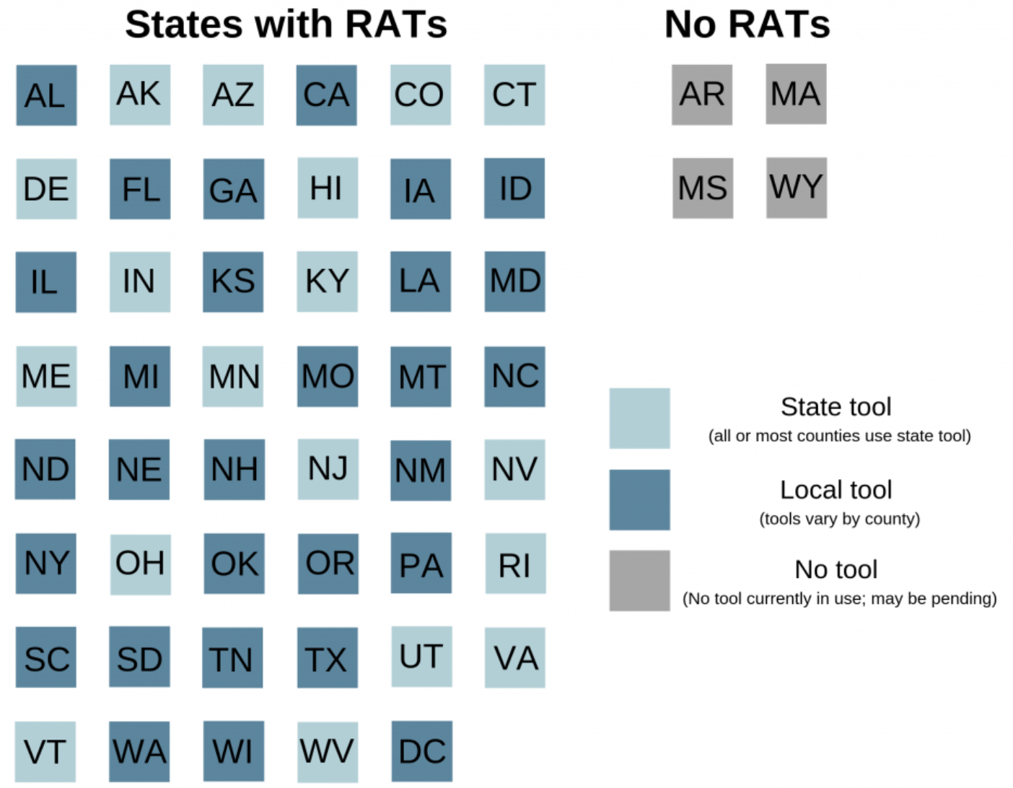
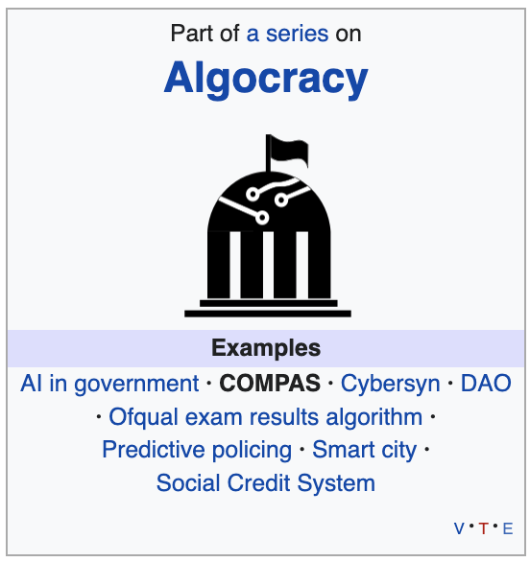
Risk Assessment Tools
Correctional Offender Management Profiling for Alternative Sanctions (COMPAS):
A case management and decision support tool developed and owned by Northpointe (now Equivant) used by U.S. courts to assess the likelihood of a defendant becoming a recidivist.
[source]
Notes:
RAT = risk assessment tool
used to inform sentencing, placement, and supervision

Slide 56
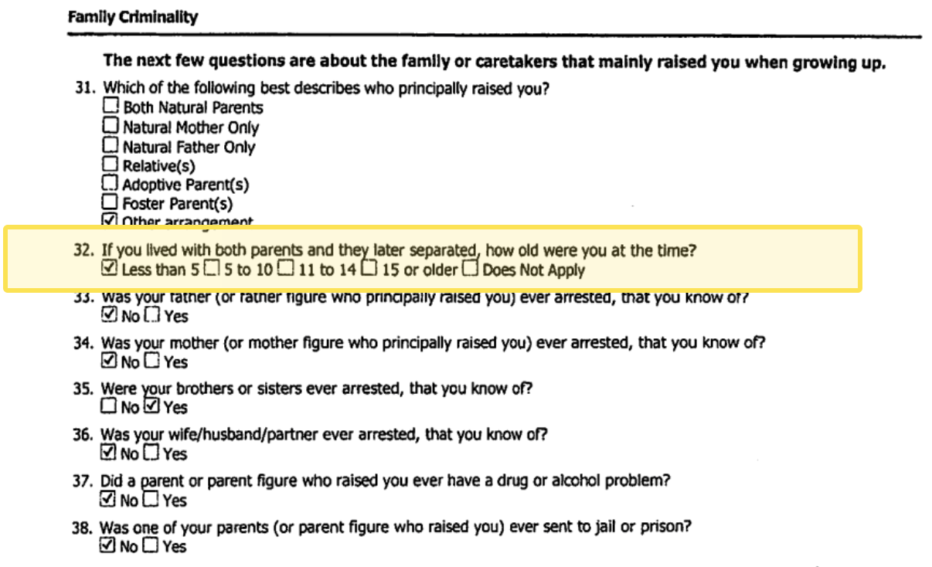
COMPAS System
Notes:
137 total questions

Slide 57
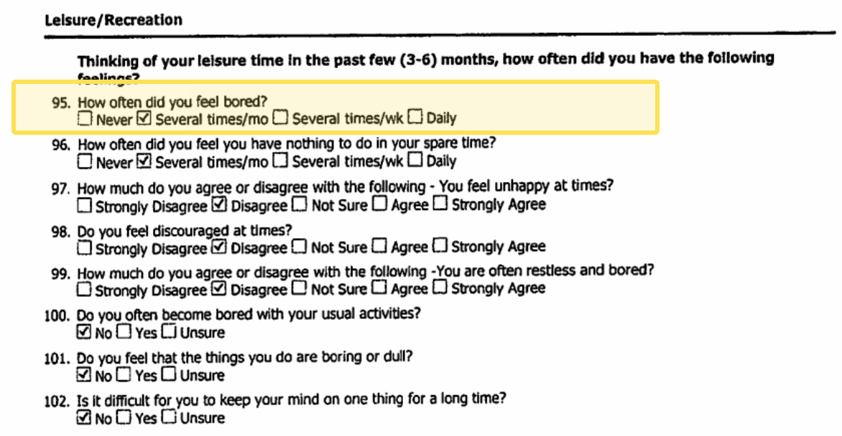
COMPAS System
[source]

Slide 58
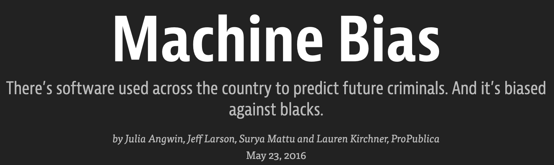
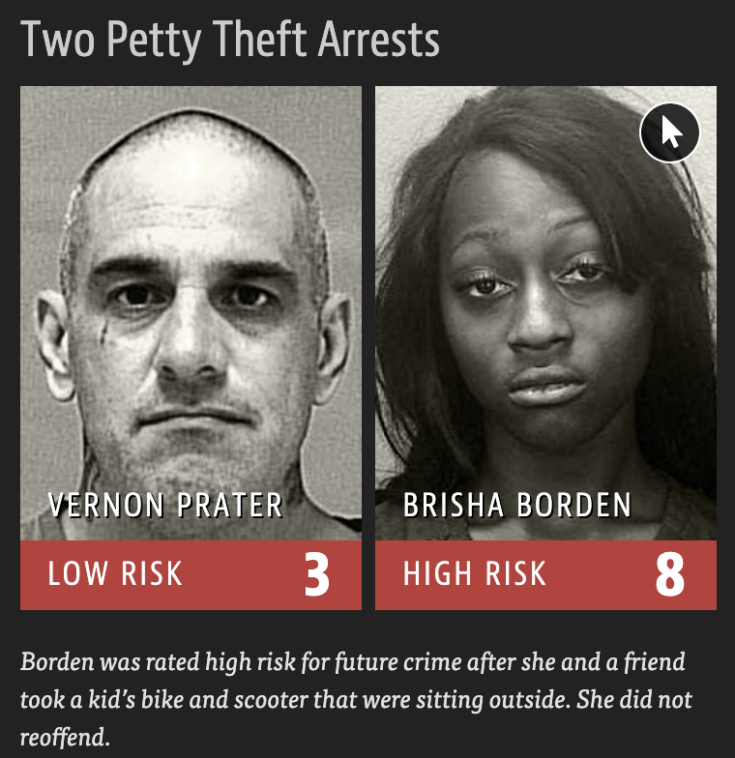
Risk Assessment Backlash
Ran a test: compare actual recidivism to predicted recidivism for ~10000 criminal defendants from a 2-year period (in Broward County, Florida)
Prediction accuracy was 61% for general crime and 20% for violent crime with no significant difference between Black and White
Black FNR was 45% while White FNR was 23% (FN gap of 22%)
[source]

Slide 59
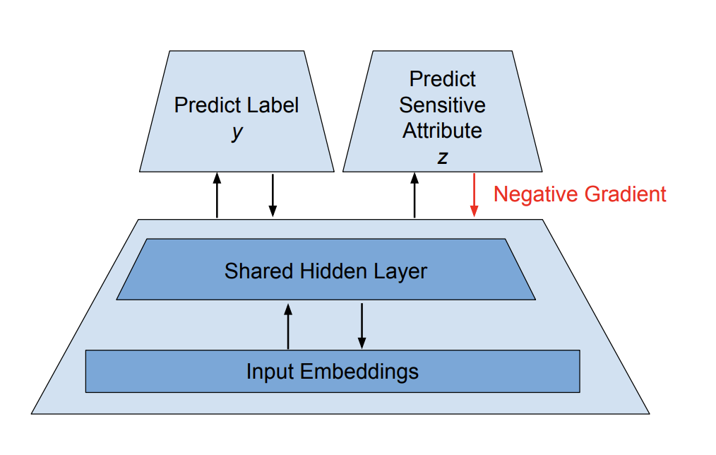
Adversarial Training
Goal: Learn to predict the target label without learning sensitive attributes
Multiple model heads
Task head
Sensitive attribute head
Flip gradient to sensitive attribute
[source]

Slide 60
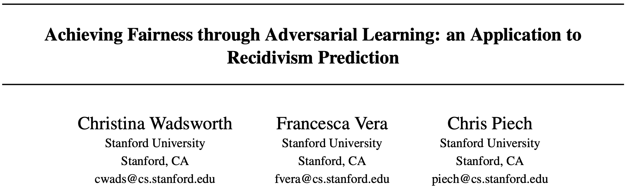

Adversarial Training
Apply adversarial training to COMPAS
Compare model performance with AUC-ROC
Compare fairness:

Slide 61


Adversarial Training
Apply adversarial training to COMPAS
Compare model performance with AUC-ROC
Compare fairness:

Slide 62
Adversarial Training

Slide 63
ML in Society

Slide 64

Framing Fairness
“Fairness and justice are properties of social and legal systems …
To treat fairness and justice as terms that have meaningful application to technology separate from a social context is therefore … an abstraction error.”
[source]

Slide 65

Questions for Consideration
Humans clearly have biases which can lead to unfair outcomes. So do ML systems. Is one worse than the other?
[source]

Slide 66

Questions for Consideration
ML models typically lack transparency. Does this make their biases more harmful? What can be done to improve the situation?
[source]

Slide 67

Questions for Consideration
How should society regulate ML decision-making as it impacts more and more aspects of our lives?
[source]

Slide 68
ML in Society

